Slide 1

Multi-Agent AI Framework for Automated Software Development AI Framework for Automated Software Development
Team Members:
2420030444 – Suhitha Chalasani
2420030398 – Kapilavai Hamsini
2420030472 – Sri Raaga Tangirala
Cluster – 2, Section 7

Slide 2
PROBLEM STATEMENT
Traditional SDLC relies heavily on manual, human-driven effort across requirement gathering, design, coding, testing, and documentation, which is time-consuming and inconsistent.
A single monolithic LLM struggles to handle an entire project end-to-end — from design down to debugging — due to the complexity and breadth of knowledge required.
Existing LLM-based systems (ChatDev, MetaGPT, AgentCoder) largely produce isolated functions or small code snippets rather than complete, multi-file, production-ready projects.
There is a need for a system that can take a single user requirement and autonomously carry it through planning, frontend/backend code generation, review, testing (with retry on failure), and documentation.

Slide 3
OBJECTIVES
Build a multi-agent pipeline where specialized agents handle distinct SDLC phases: Requirement Analysis, Planning, Code Generation, Frontend, Backend, Code Review, Testing, and Documentation.
To use LangGraph as the orchestrator to decide agent sequencing, pass information between agents, maintain shared state, and manage retries.
To maintain a shared state object (project name, language, framework, database, completion flags) so agents don't repeat questions to the user.
Use Llama 3.x (via Groq) for reasoning and code generation, chosen for fast inference, no GPU requirement, and a free tier.
Implement a testing feedback loop: if generated code fails tests, control returns automatically to the Code Generation agent for regeneration.
Use Docker for sandboxed, consistent execution/testing of generated code.

Slide 4
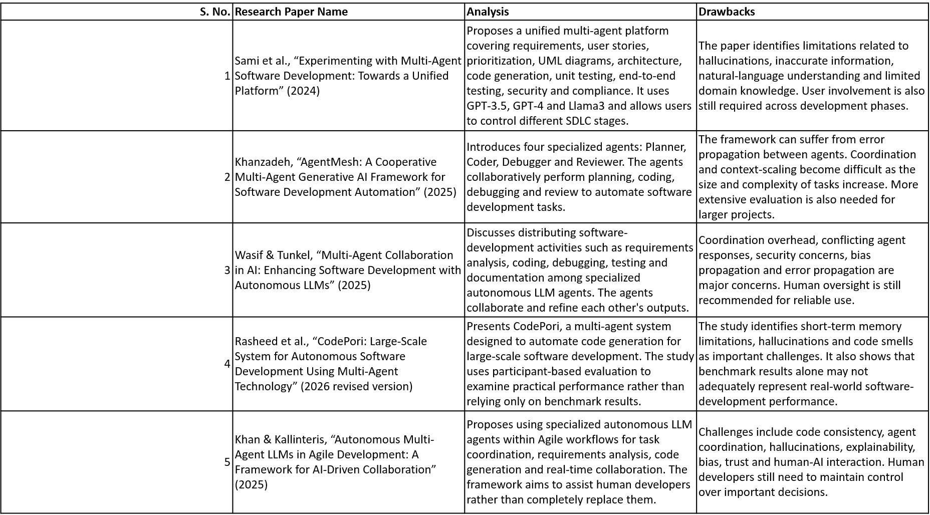
Literature Survey

Slide 5
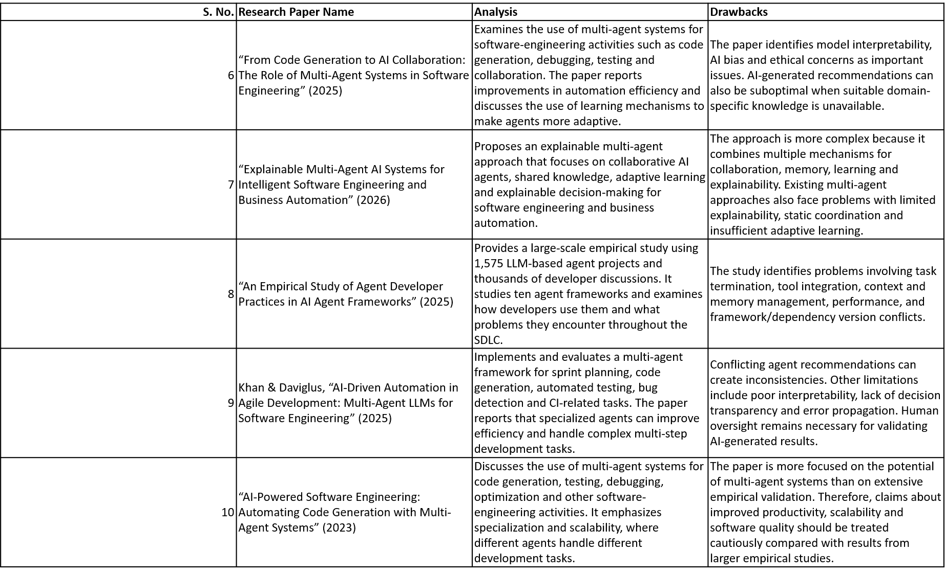
Literature Survey

Slide 6
RESEARCH GAPS IDENTIFICATION
Most existing frameworks (ChatDev, MetaGPT, AgentCoder) generate isolated functions rather than complete multi-file projects with a working feedback loop between testing and code generation.
CodePori's practitioner evaluation shows that even advanced multi-agent systems suffer from hallucination, short-term memory loss across files, and orchestration failures, i.e., problems not caught by standard benchmarks (HumanEval, MBPP).
AgentMesh acknowledges its debugging loop but is limited to single-agent context windows and lacks a dedicated orchestrator for larger, multi-file coordination.
Sami et al.'s platform separates requirements, architecture, and code generation well, but doesn't describe an automatic retry loop between testing failure and code regeneration.
Most systems in the literature rely on paid, closed models (GPT-3.5/4, Claude) rather than a fast, low-cost, open-weight inference path, i.e., leaving room for a Llama + Groq-based pipeline that keeps cost and setup overhead low.

Slide 7
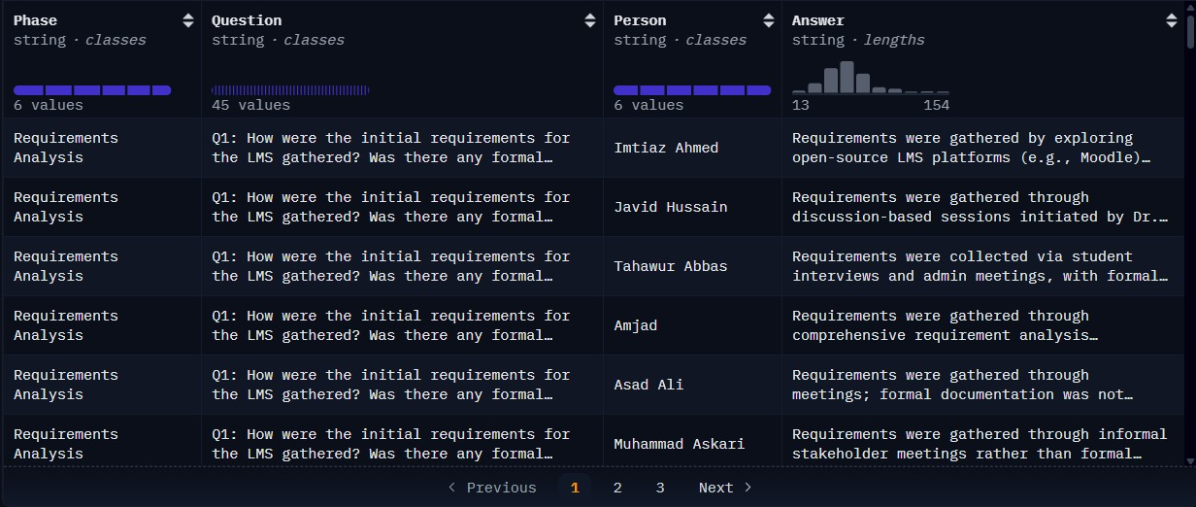
DATASETS
Datasets
HuggingFace | https://huggingface.co/datasets/BasitAliii/sdlc-scenario-based-qa-dataset
Kaggle | ai_multi_agent_interactions_2026.csv
Github | https://github.com/GPT-Laboratory/CodePori_v02

Slide 8
INNOVATION, CREATIVITY & NOVELTY
Orchestrator-driven design: LangGraph explicitly manages agent sequencing, shared state, and conditional loops (e.g., Testing → Fail → back to Code Generation → regenerate), rather than a fixed linear pipeline
Inference choice: Llama 3.x served through Groq — fast, no GPU required, free-tier available — as opposed to relying solely on paid APIs like GPT-4 or Claude used in most reviewed systems.
Role split at the code-generation stage: separate Frontend and Backend agents feeding into a shared Code Review and Testing stage, rather than one generalized “coder” agent.
Swappable backend: the architecture allows replacing Groq with a locally hosted Llama model without redesigning the rest of the system.
Sandboxed execution: Docker isolates generated code during testing/execution, addressing a safety concern flagged in the AgentMesh paper.

Slide 9
FEASIBILITY
Each component (Flask, LangGraph, Groq API, Docker, Git) is an existing, actively maintained technology — no dependency on unreleased tools.
Groq's free tier removes the GPU/hosting cost barrier that would otherwise be required to run Llama models.
Similar multi-agent pipelines (CodePori, AgentMesh, Sami et al.'s platform) have already demonstrated that this general approach — decomposing SDLC into agent roles — is technically achievable, even if code quality still needs refinement.
The retry loop (Testing → Code Generation) is a straightforward conditional edge in LangGraph, not a novel algorithmic challenge.
Known risks from the literature (hallucination, short memory, code smells) are documented, which allows the project to plan explicit review/testing stages rather than treating these as unexpected failure modes.

Slide 10
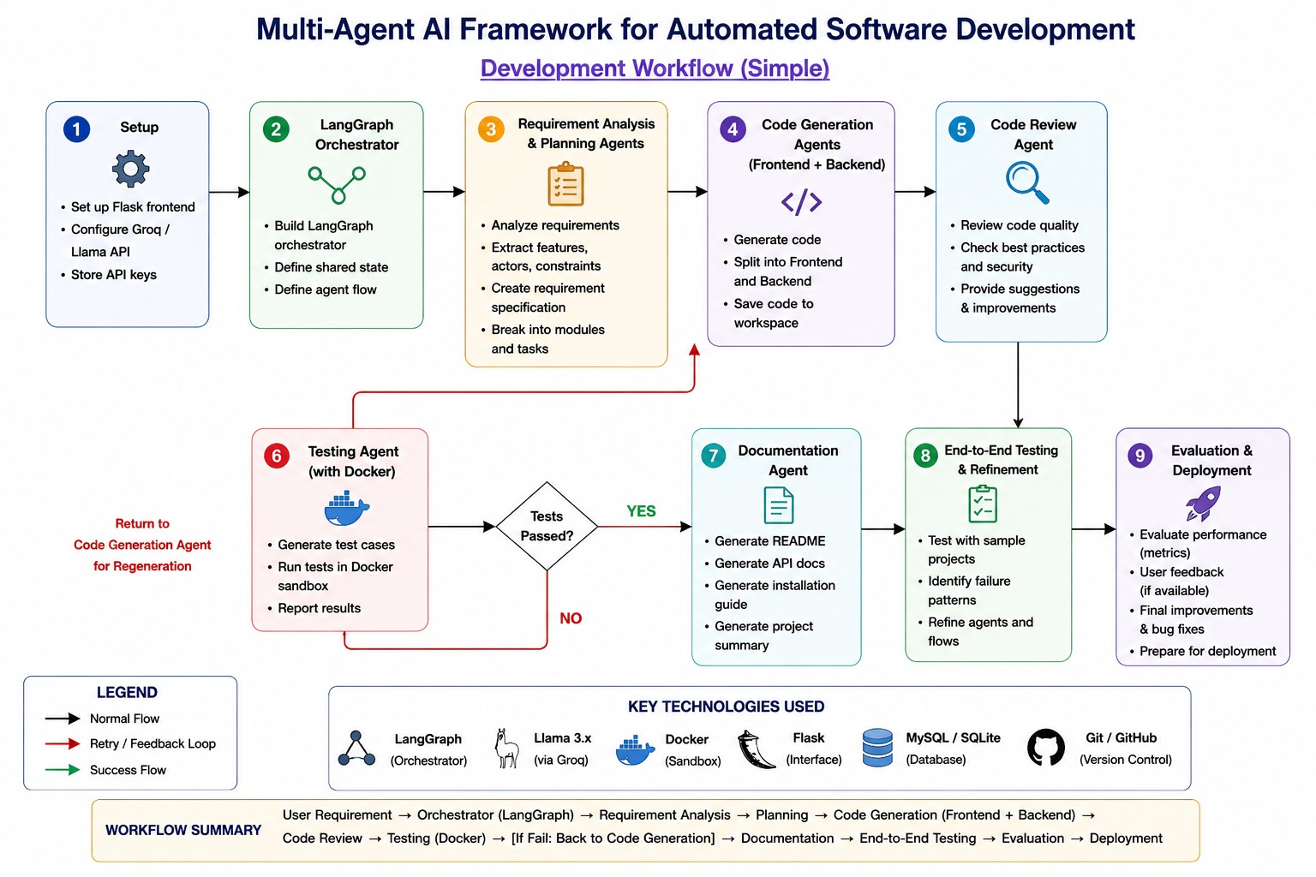
PROJECT PLAN

Slide 11
Thank you

